Slide 1
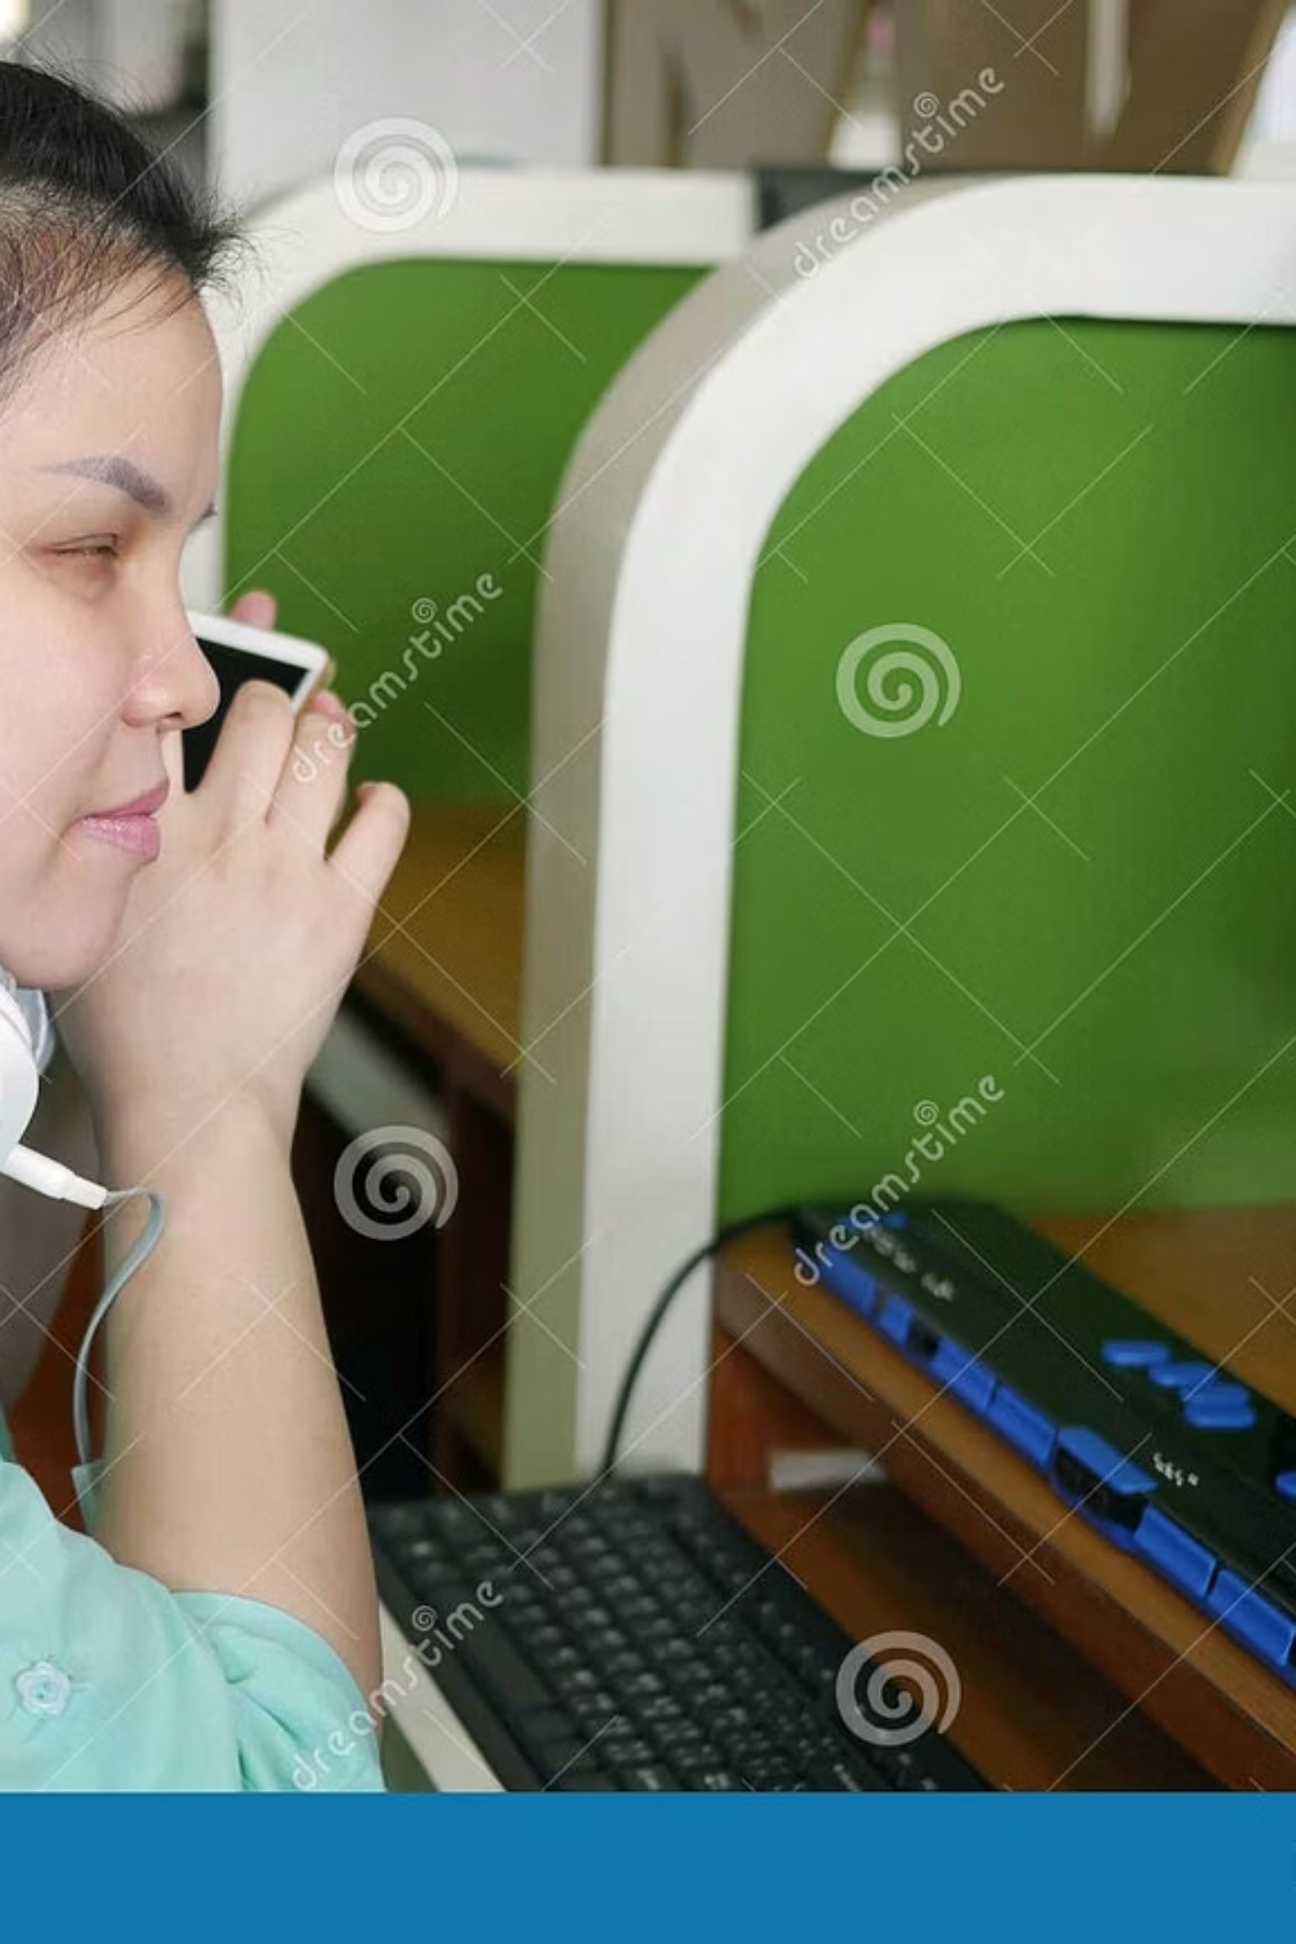

N.A.I.N.A
Neural Accessibility & Interaction for Natural Assistance
Team Name: HangmanxRooster
Member Name: Yugansh Joshi (Frontend & User Experience) Vansh Bansal(AI & Processing)

Slide 2
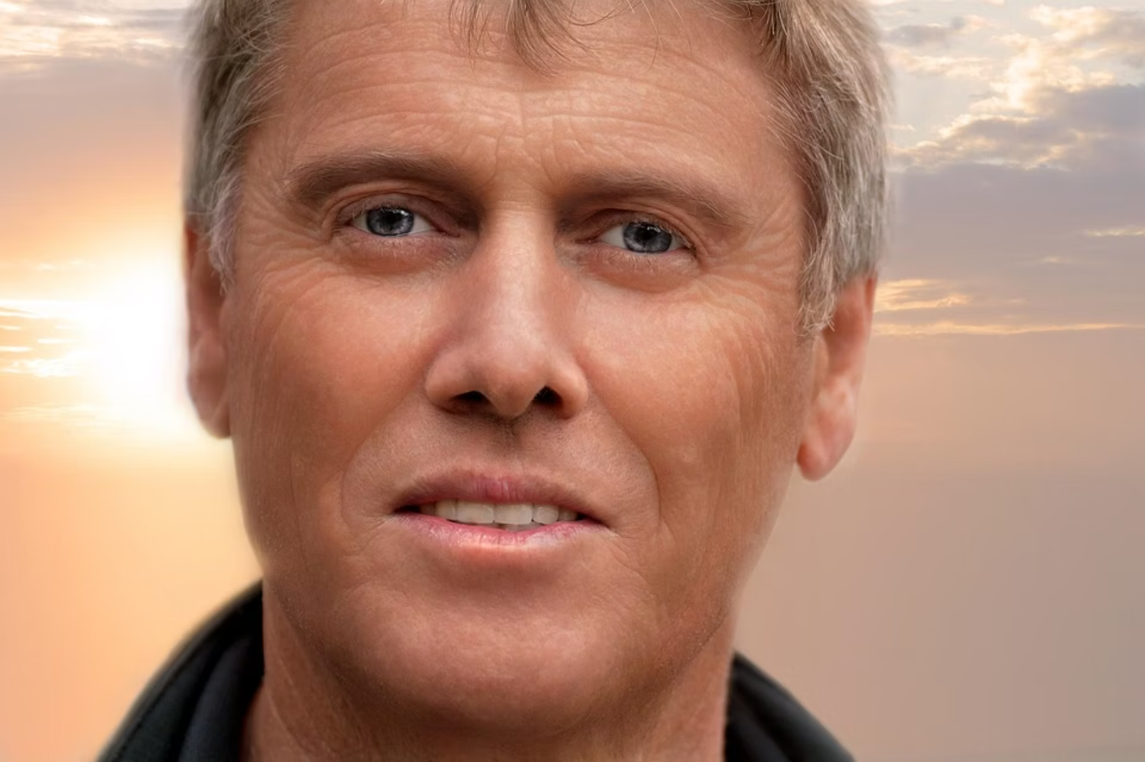
The Accessibility Crisis
Real-World Barriers
Over 1.3 billion people worldwide face daily digital accessibility challenges. Current solutions are fragmented, expensive, or require specialized hardware that many cannot access.
Text recognition struggles with handwritten content
Limited sign language support across platforms
Poor integration between assistive technologies
The gap between digital innovation and inclusive design continues to widen, leaving millions behind.

Slide 3

Introducing N.A.I.N.A
A comprehensive AI-powered accessibility platform that breaks down digital barriers through intelligent recognition and adaptive interaction.
Optical Character Recognition
Voice Integration
Real-time text extraction from images and live camera feeds with 95%+ accuracy
Seamless text-to-speech and speech-to-text powered by Web Speech API
Sign Language Recognition
Adaptive Interface
Hand gesture detection and interpretation using advanced computer vision
Dynamic font adjustment and screen reader optimization for personalized experiences

Slide 4
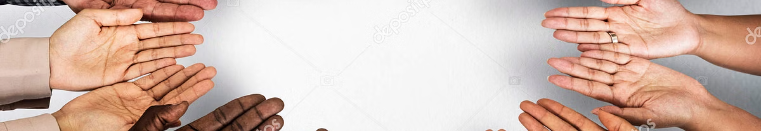
Our Mission & Vision
01
02
Eliminate Digital Barriers
Universal Design Principles
Create seamless accessibility experiences for users with visual, hearing, and motor impairments
Build technology that works for everyone, regardless of ability or device limitations
03
04
Empower Independence
Scale Global Impact
Enable users to navigate digital spaces confidently without external assistance
Reach millions of users worldwide through accessible, affordable technology solutions

Slide 5




Powerful Technology Stack
Core Languages
JavaScript ES6+ for robust client-side functionality and responsive user interactions
UI Framework
Tailwind CSS for rapid, accessible styling with built-in responsive design patterns
AI/ML Libraries
TensorFlow.js, Tesseract.js, and Fingerpose for intelligent recognition capabilities
Built with Web Speech API for natural voice interactions and optimized for cross-platform compatibility.

Slide 6
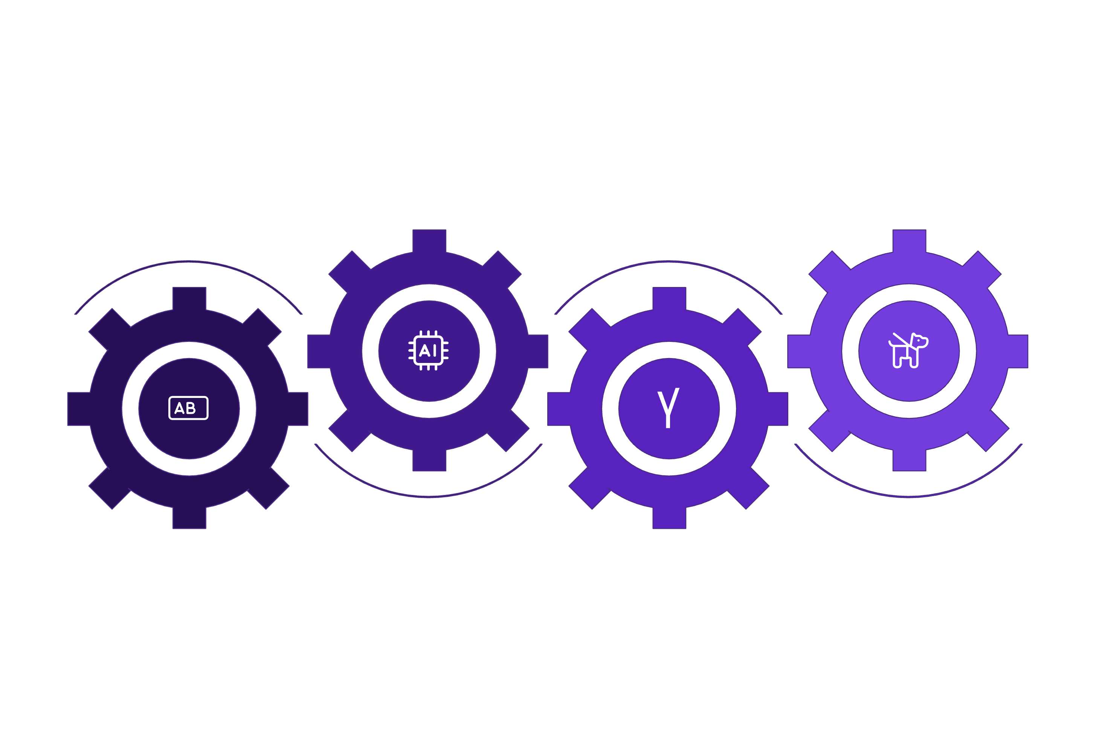




System Architecture
AI Processing
Accessibility Output
OCR, speech & gesture modules
TTS, visual display, haptics
Multimodal Input
Integration Layer
Camera, mic, and text sources
Fuse and contextualize modalities
Our intelligent pipeline processes multiple input modalities simultaneously, ensuring users can interact through their preferred method while receiving output in their optimal format.

Slide 7







Revolutionary Features
Live OCR Engine
Gesture Intelligence
Real-time text recognition from camera feeds with instant audio feedback and visual highlighting
Advanced hand tracking recognizes sign language and custom gestures for intuitive control
Seamless Voice Integration
Bidirectional speech processing with natural language understanding and contextual responses
Innovation meets inclusion – technology that adapts to human diversity rather than forcing conformity.

Slide 8

Development Roadmap
Concept & Research
1
User research, accessibility audit, and AI model selection completed
2
Core Prototype
OCR integration, basic TTS/STT functionality, and responsive UI framework built
AI Enhancement
3
Sign language recognition, gesture detection, and machine learning optimization implemented
4
Testing & Deployment
User testing with accessibility community, performance optimization, and production launch
Live Demo Ready: Functional prototype showcasing core OCR, TTS, and gesture recognition capabilities available for testing.

Slide 9

Challenges & Solutions
Technical Hurdles
Recognition Accuracy: Implemented ensemble AI models with 95%+ precision
Processing Latency: Optimized algorithms for sub-200ms response times
Device Compatibility: Progressive web app ensuring cross-platform functionality
Risk Mitigation Strategy
Continuous user feedback loops, fallback mechanisms for offline functionality, and extensive cross-browser testing ensure reliable performance across diverse use cases.

Slide 10
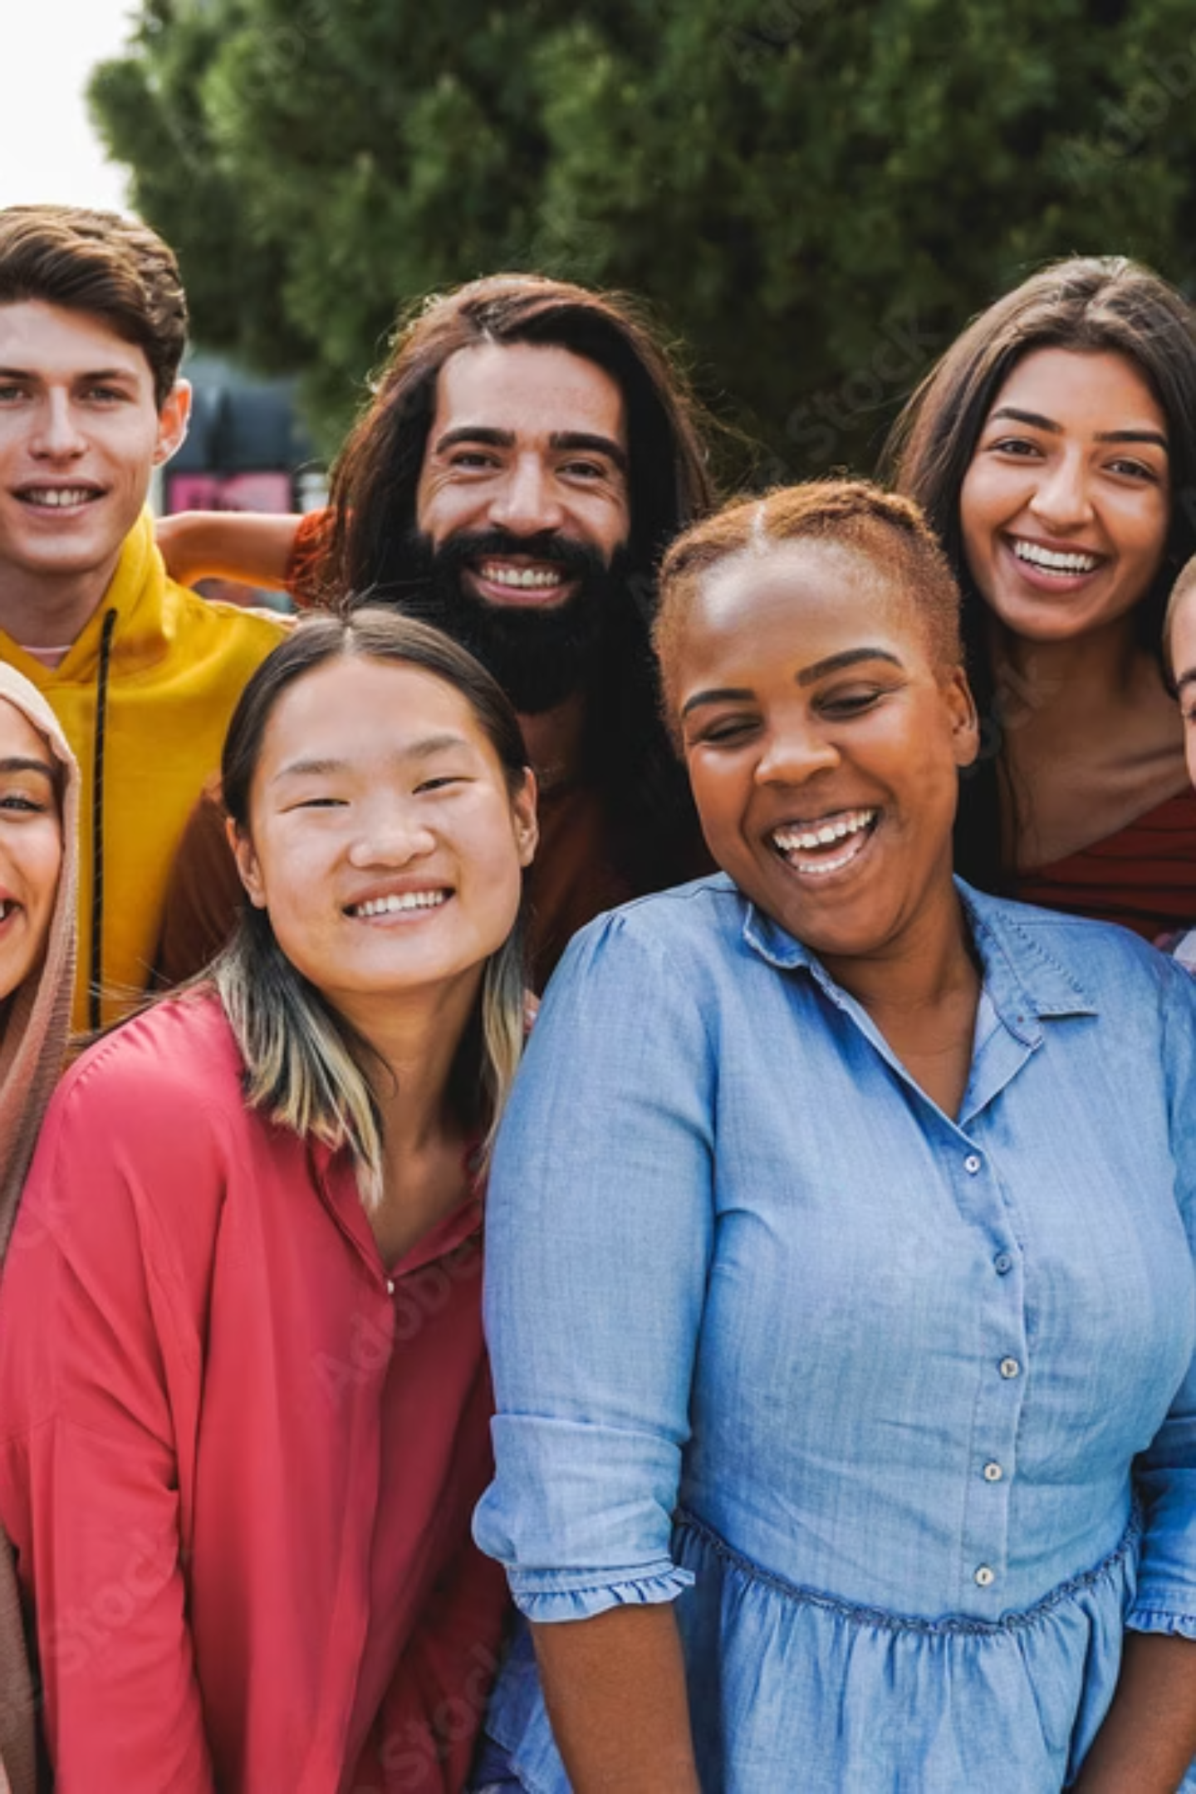
Transforming Lives Through Technology
1.3B
95%
0
Global Impact
Accuracy Rate
Cost Barrier
People worldwide who will benefit from improved digital accessibility
OCR and gesture recognition precision achieved in testing
Free, open-source solution accessible to everyone
Building a more inclusive digital future, one interaction at a time.
N.A.I.N.A represents more than technological innovation – it's a commitment to human dignity and equal access to information. Together, we can eliminate digital barriers forever.

Slide 11


